Slide 1
interactive learning center
R&D
Research & Development
ILC
Notes:
Why they call them teaching hospitals.

Slide 2

We create “COOL Stuff”
Value Add

Slide 3
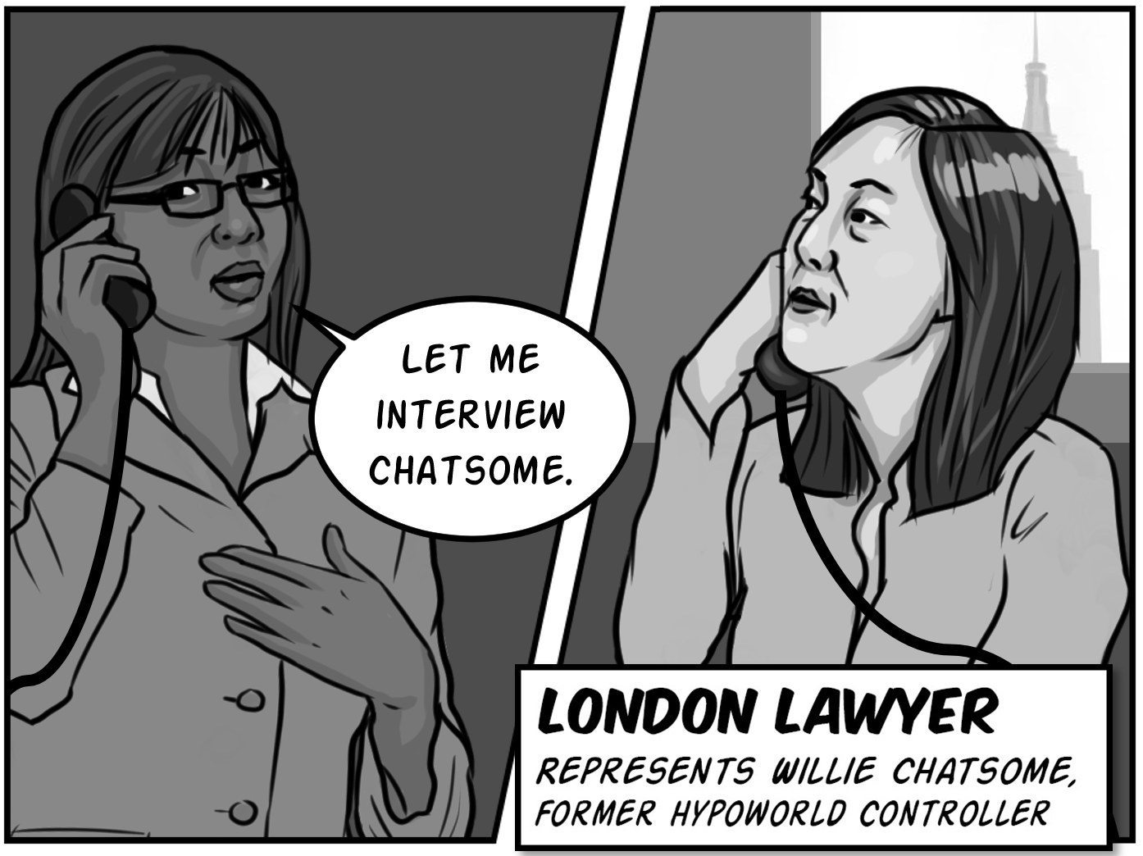
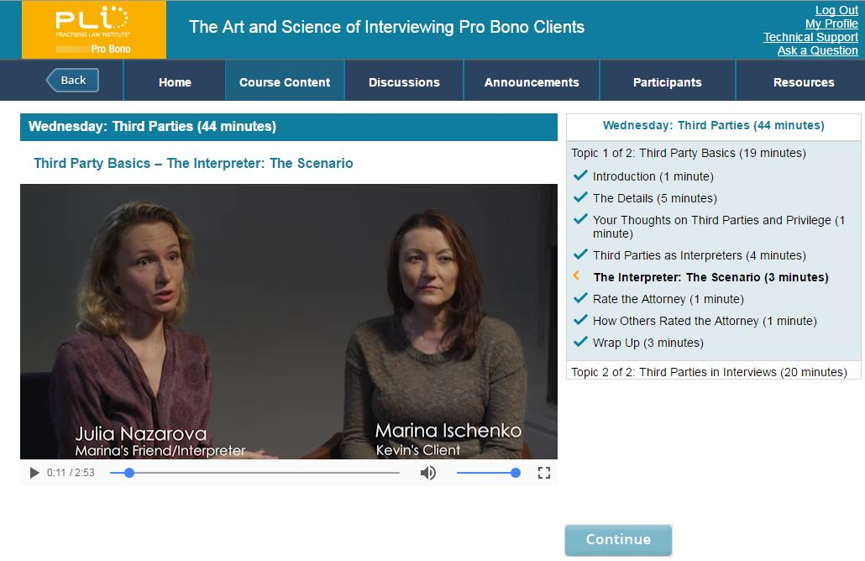
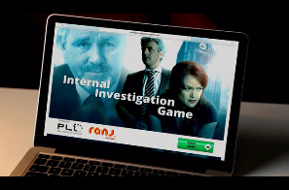
Learning innovation
High-quality production
Instructional design

Slide 4
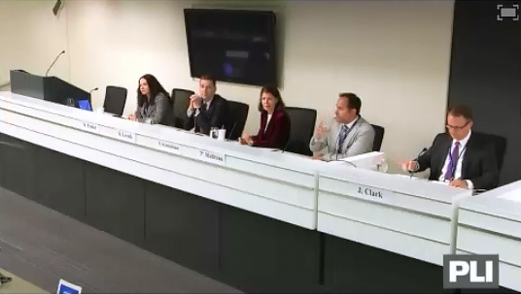
dual mission
enhancing live programs
developing online programs
Notes:
Work with faculty to improve programs, basing advice on empirically-based findings relevant to understanding, remembering and improving performance.

Slide 5
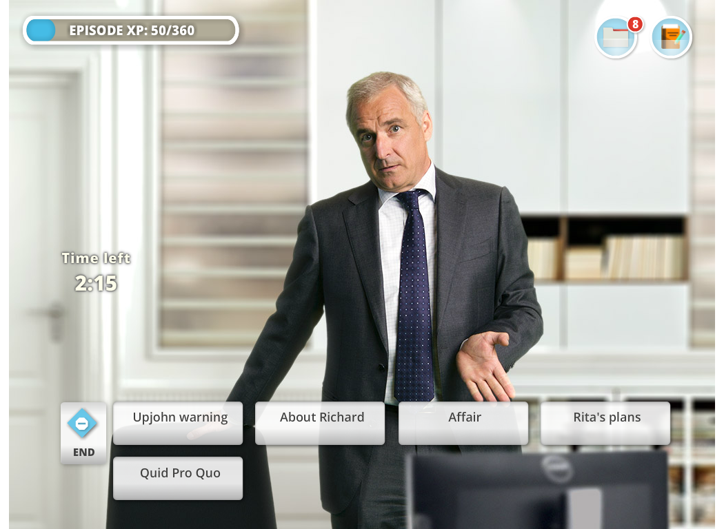
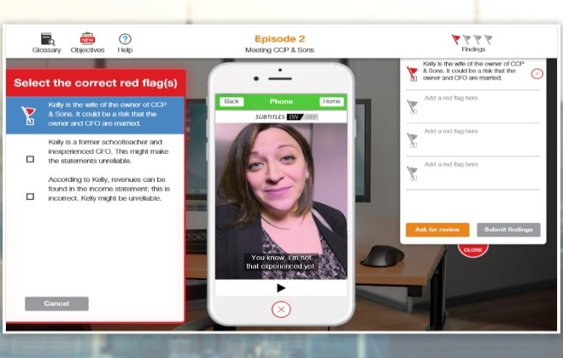
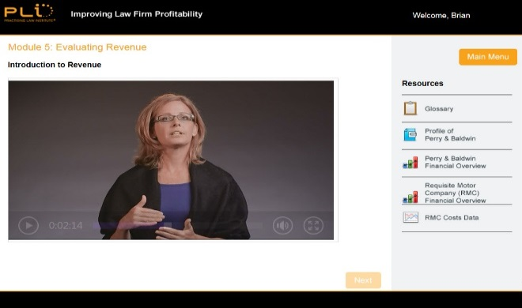

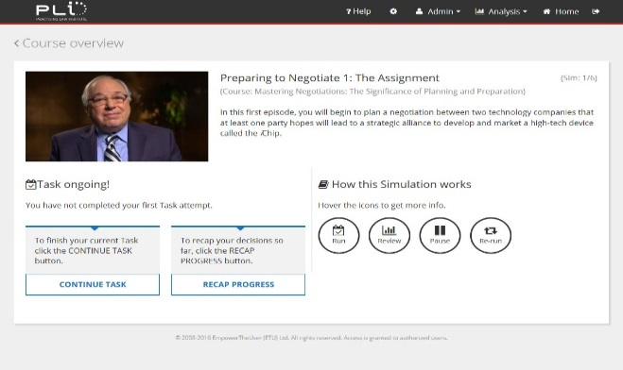
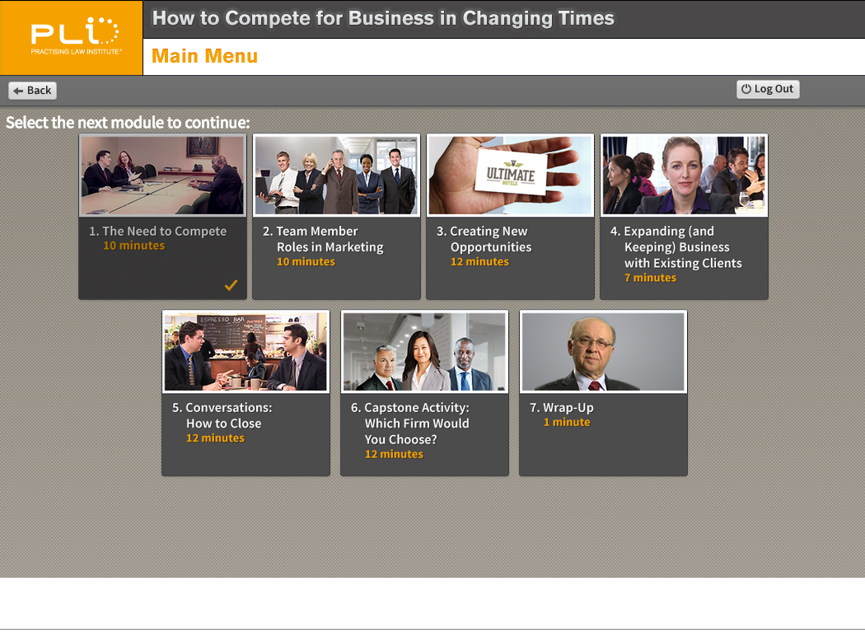
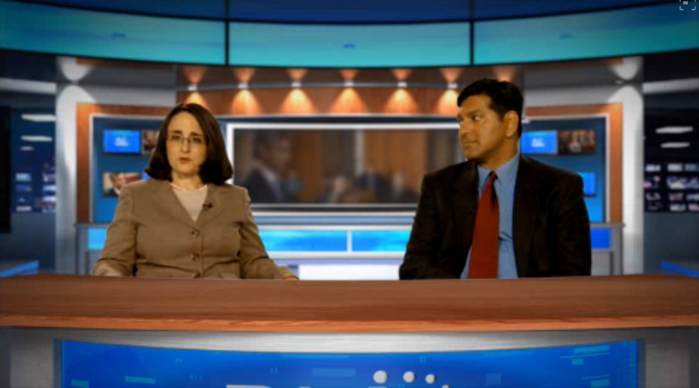
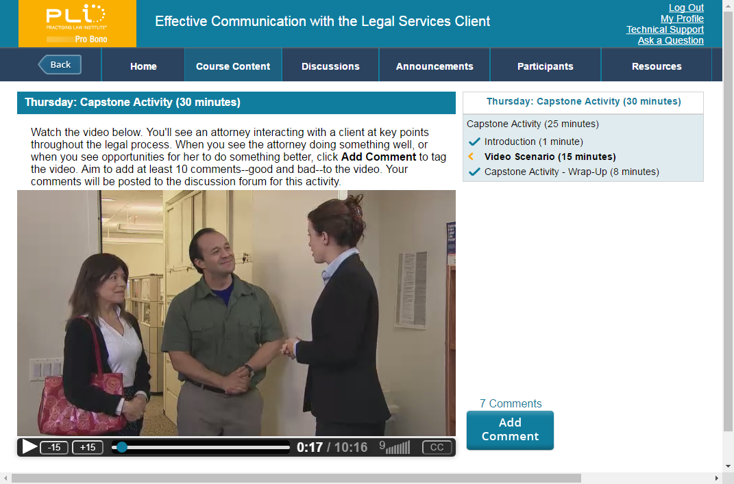
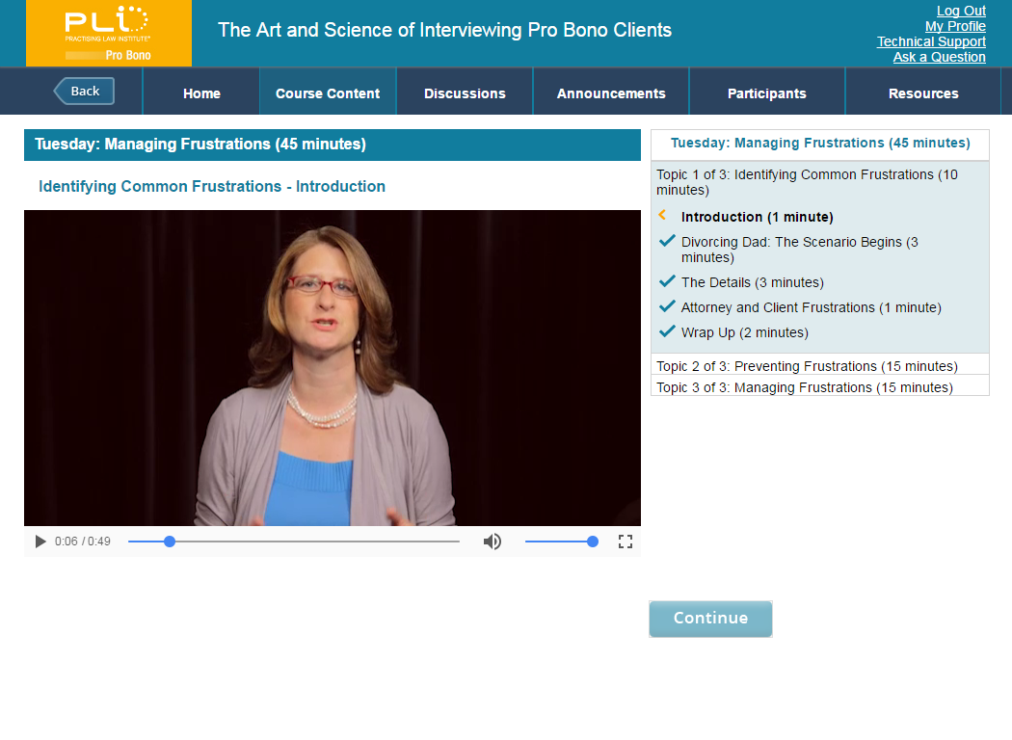
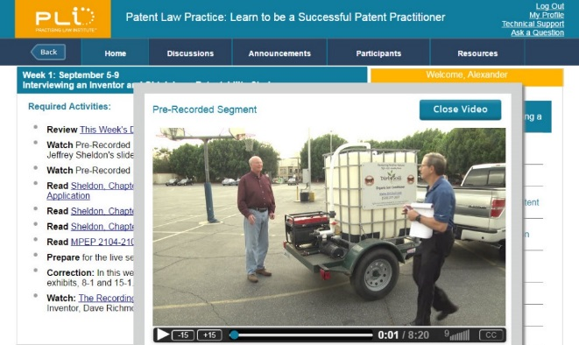

ilc courses
Internal Investigation Game
NEW!
Financial Statements Game
Improving Law Firm Profitability
NEW!
Mastering Negotiations: The Significance of Planning and Preparation
How to Compete for Business in Changing Times
PLI's Trial Advocacy Training Program
Effective Communication with the Legal Services Client
The Art & Science of Interviewing Pro Bono Clients
Patent Law Practice

Slide 6
interactive learning center
R&D
Research & Development
ILC
Notes:
Why they call them teaching hospitals.

